Slide 1
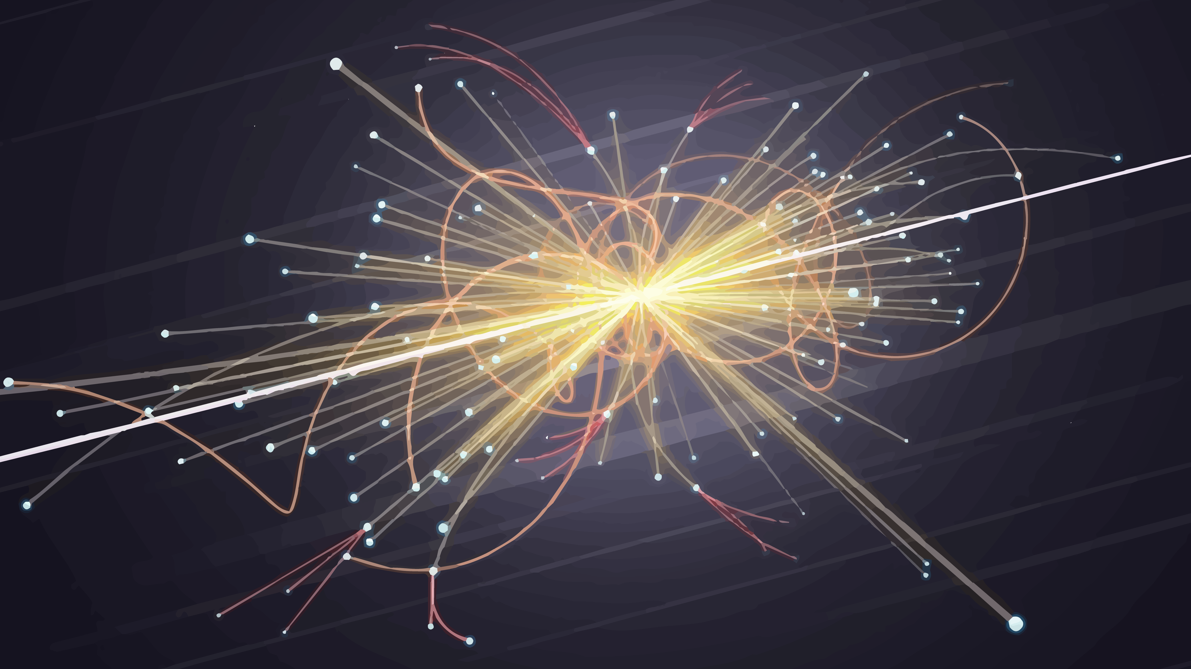
The particle problem
Adithya A Rao​​

Slide 2
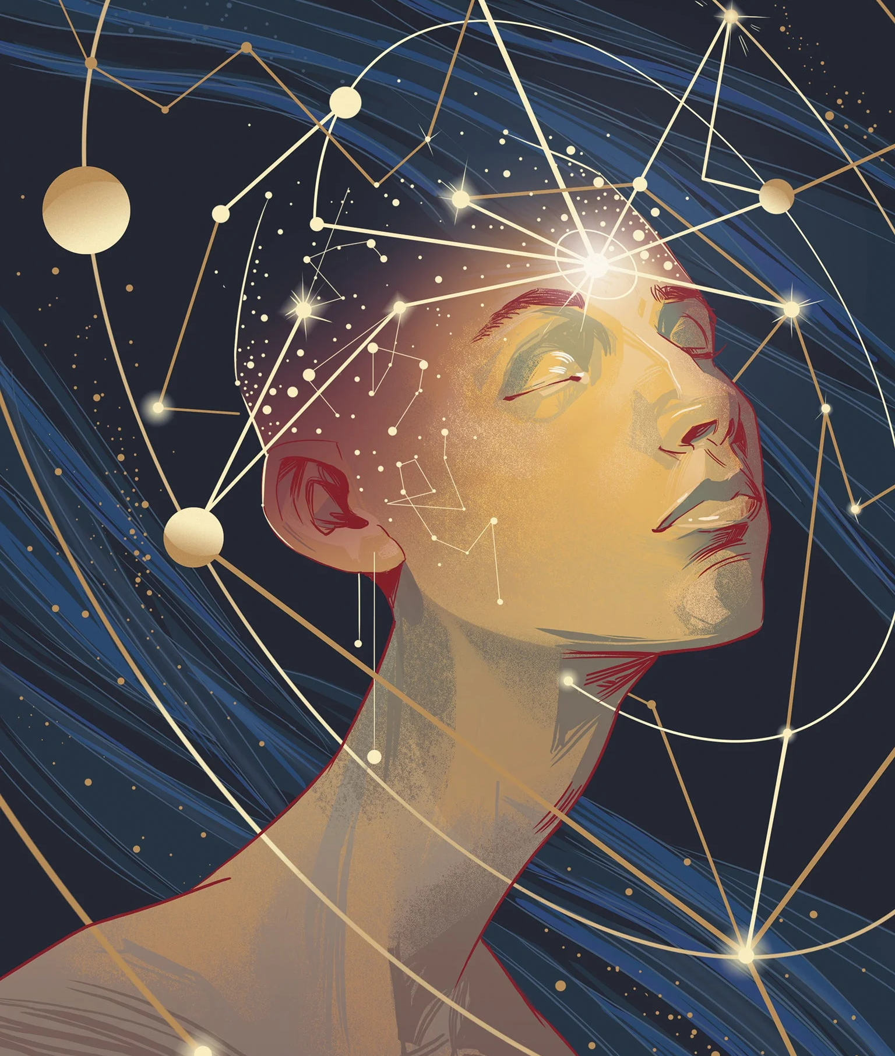
INTRODUCTION
In general physics addresses 2 questions –
The HOW and the WHAT
In this talk I will be mostly dealing with WHAT – what the universe around us is made of and as a spice to your intellect, I will be talking about the misfits of the model – the neutrinos

Slide 3
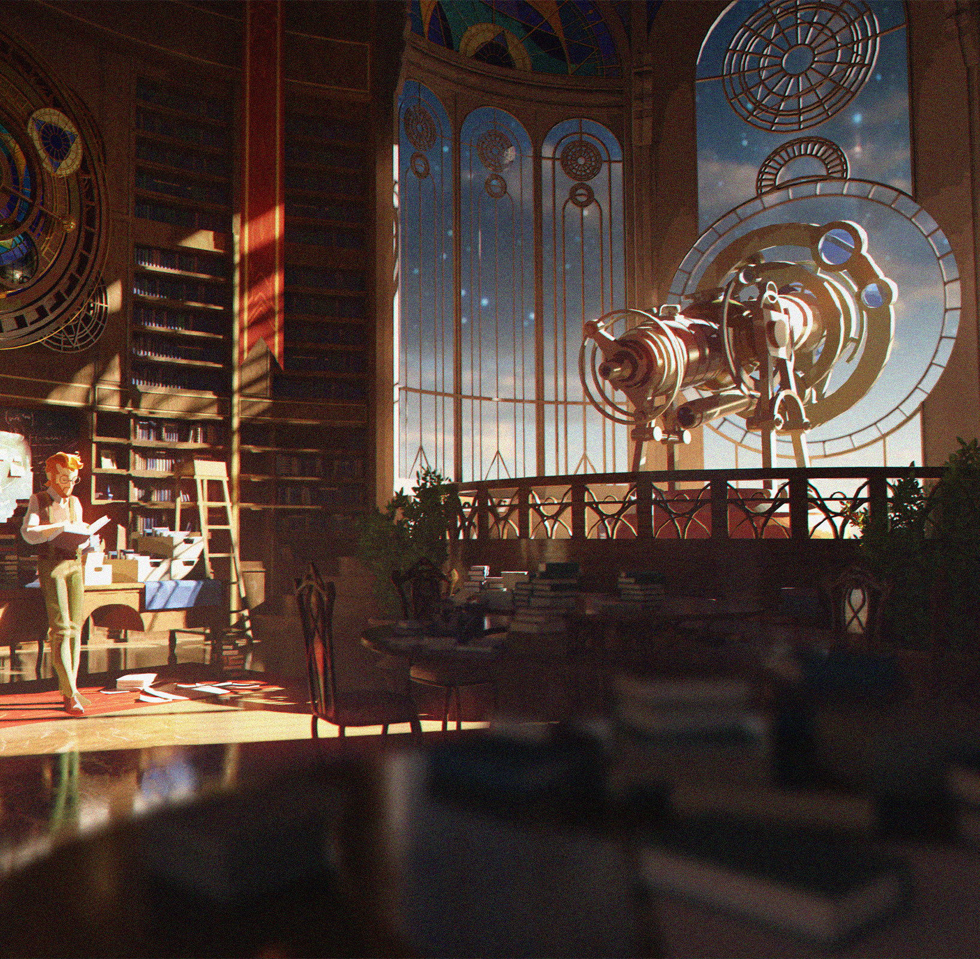
The Old school physics
The question WHAT the universe is made of has haunted philosophers for thousands of years.
Answers ranged from things being made of fire, water, air and earth to the atom being a literal plum pudding.
But with better devices and techniques came better theories and deeper understanding of WHAT the universe is made of.
The count of particles was small, the understanding was deep and people were satisfied with the way physics was heading.
Notes:
Thomson – electron
Rutherford – nucleus
Chadwick – neutron
Dirac – antiparticles.

Slide 4
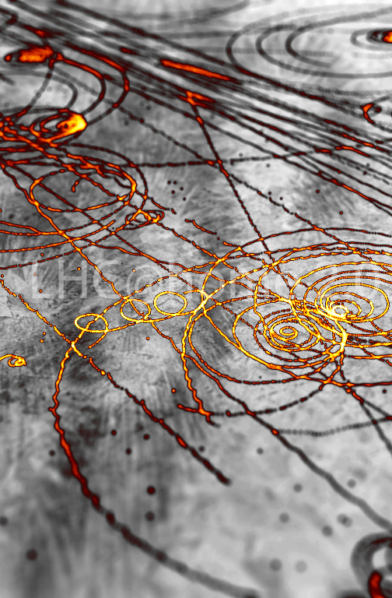
The particle Zoo
Important question – what holds protons together in nucleus.
Yukawa proposed strong force between protons as being due to the exchange of force carrying particles. This particle was massive since the force was short ranged, and Yukawa called it the ‘meson’ which literally meant of medium mass. With this, the search for this meson started all over the world. Ultimately something with similar mass was found. 10 years later, it was found that this particle was not the Yukawa meson but rather a new particle, not fitting anywhere in the theory. The invasion of particles into the physics textbooks had begun.
In upcoming years, in cosmic ray detections and accelerators, so many new and strange particles were discovered, with a variety of masses, lifetimes and other properties. People were in a frenzy; the physics community was going crazy. A new theory had to be invented to accommodate them.
Notes:
Yukawa meson mass – 100MeV
Proton – 938 MeV
Electron – 0.5 MeV
Rabi – who ordered this?

Slide 5
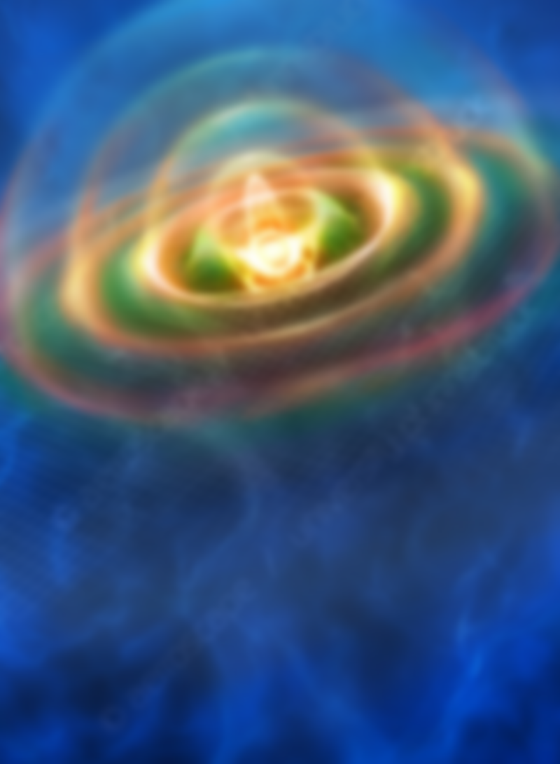
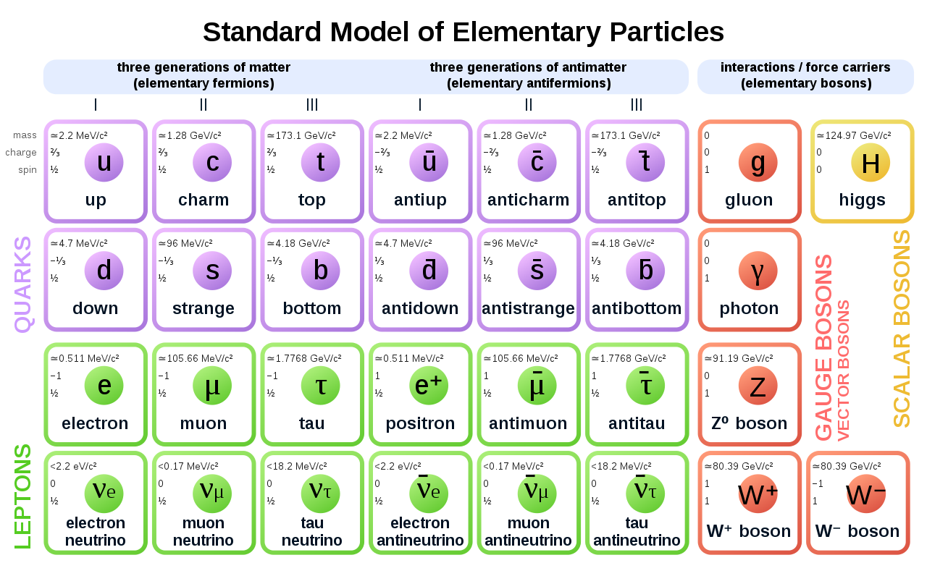
The standard model
FIELDS
EXCITATION OF FIELDS
INTERACTION BETWEEN FIELDS

Slide 6
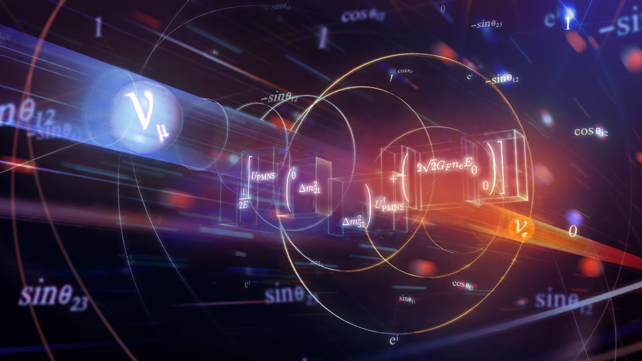
The neutrinos
Notes:
Up till now, it was a story of how particle physics came to be. The standard model even though is so well written, it is not free of problems. A lot of puzzles haunt the standard model and here I am going to talk about one of those puzzles.

Slide 7
The standard model Now Complete
The six leptons of the standard model have corresponding neutrinos.
But where do these come from?
Notes:
The standard model AKA quantum field theory is the physicist’s version of the periodic table.

Slide 8
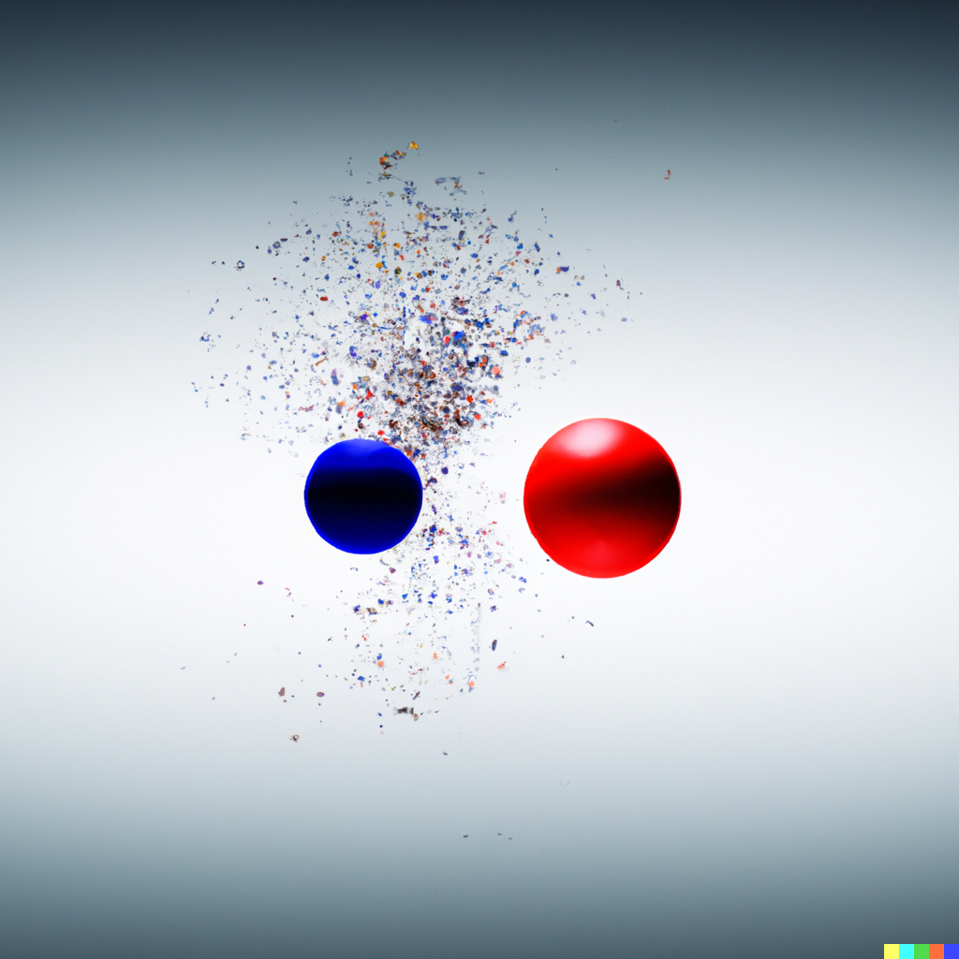
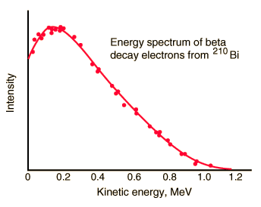
BETA Decay
The problem
Beta decay involves the conversion of a neutron into proton with the ejection of an electron.
Laws of conservation – Energy of electron should depend only on the difference in mass of the proton and neutron, which means all beta decay electrons should have a fixed energy.
Observed – Electron energy was continuous, with the supposed fixed value being the maximum observed value.

Slide 9
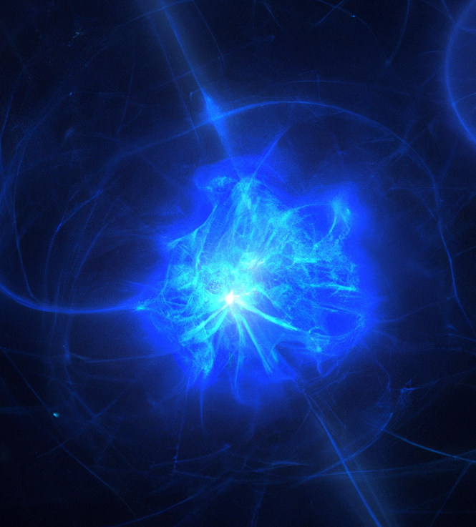
Possible solutions
The conservation law is wrong.
Energy is never conserved in any process.
1​
There was something fundamentally missing in the decay. Some particle that could carry away the missing energy.
2
Pauli suggested that the second is the right solution. He proposed a neutral, zero-mass particle Neutron that could carry away the energy. Once Fermi took up Pauli’s particle, renamed it as Neutrino and wrote his theory of beta decay, the scientific community accepted the second solution.
Later, experiments indicated the existence of two different neutrinos – termed the muon and tau neutrino.
But the problems with neutrinos were not over…
Notes:
Neutrino detection – Cowan and Reines.

Slide 10
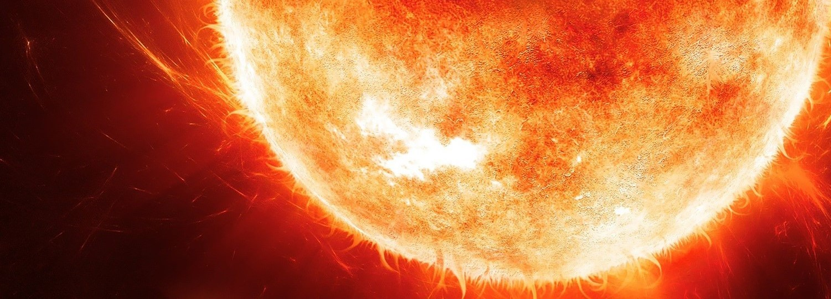
Solar neutrino problem
When experimentalists pointed their detectors at the sun, expecting to detect a few trickles of the stream of neutrinos, shockingly they observed that only 1/3rd of the expected number of neutrinos were detected.
The possible reasons for this discrepancy –
The experiment was wrong
The solar model used to calculate the expected number of neutrinos was wrong.
The neutrinos changed their type on their way from sun to the earth.

Slide 11
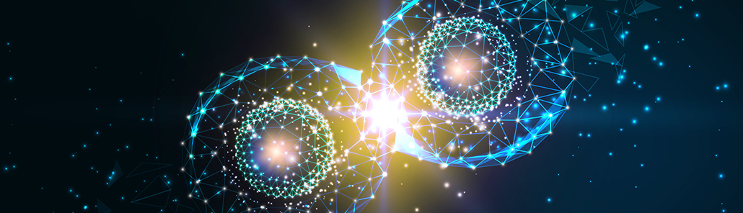
Quantum mechanics 101
State Vector
Probability amplitude
Observables
Eigenvalues/Eigenvectors
Schrodinger’s equation

Slide 12
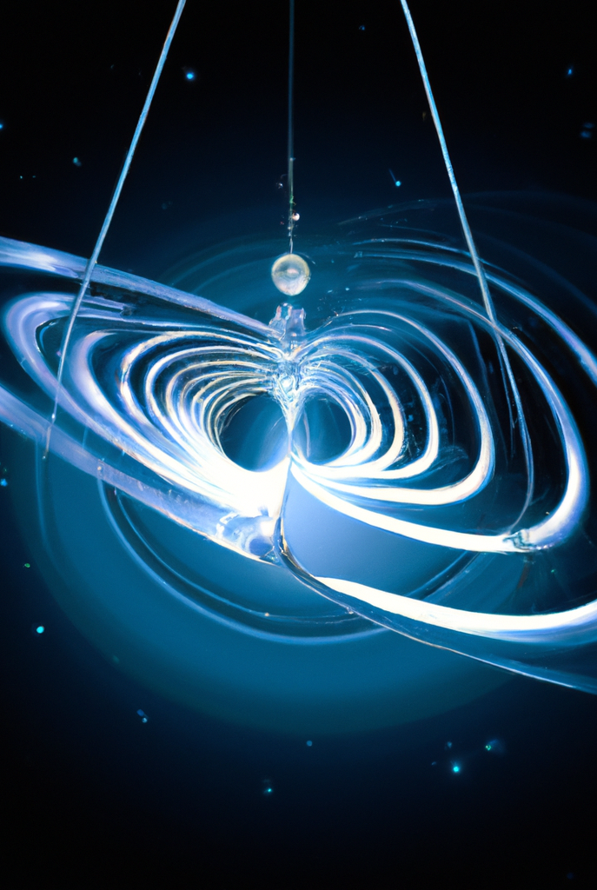
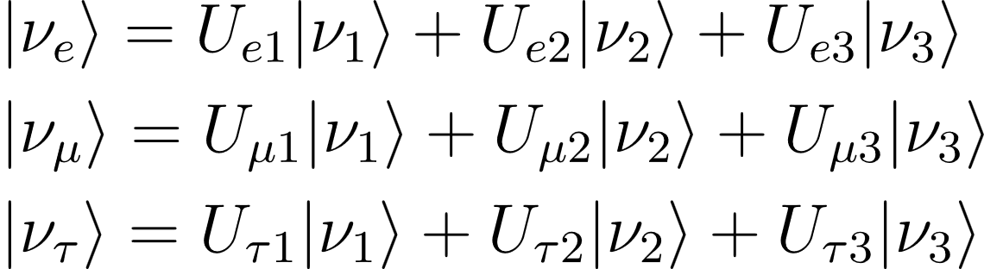
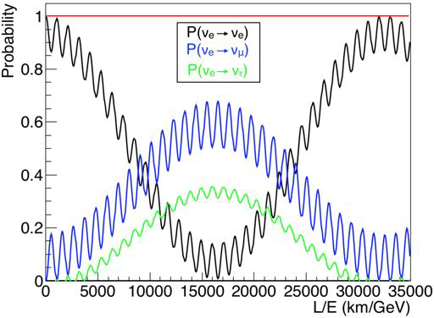
Neutrino Oscillations
The flavor eigenstates are not the eigenstates of Hamiltonian. They are superpositions of the Hamiltonian eigenstates ‘Mass states’.
Thus, with time, the evolution changes the superposition.
The electron neutrino that left off from the sun after some time becomes a mixture of electron muon and tau neutrino. When observed on earth, the neutrino is only part electron neutrino, and thus has only 34% chance that it registers as an electron neutrino.
Notes:
Talk about Mass square difference -> Mass
But hey, I told you I was going to talk about one of the weirdest particles in the story. And the story is not over yet.

Slide 13
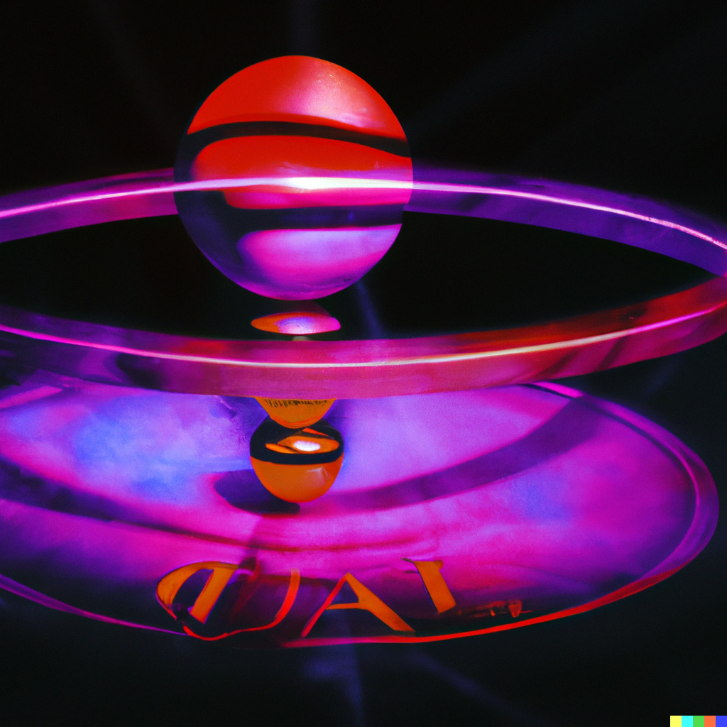
Neutrino Mass Problem
Standard model particles get mass via Higgs Field which marries the left-handed particles to their right-handed counterparts.
Neutrinos are always left-handed.
Meaning Higgs field can’t give neutrinos mass. So where does it come from?
There are many proposed solutions like the seesaw mechanism, etc. all point at particles beyond the standard model.
The problem is still open, and a lot of research is being devoted to understanding the origin of the neutrino mass.
Notes:
chirality

Slide 14
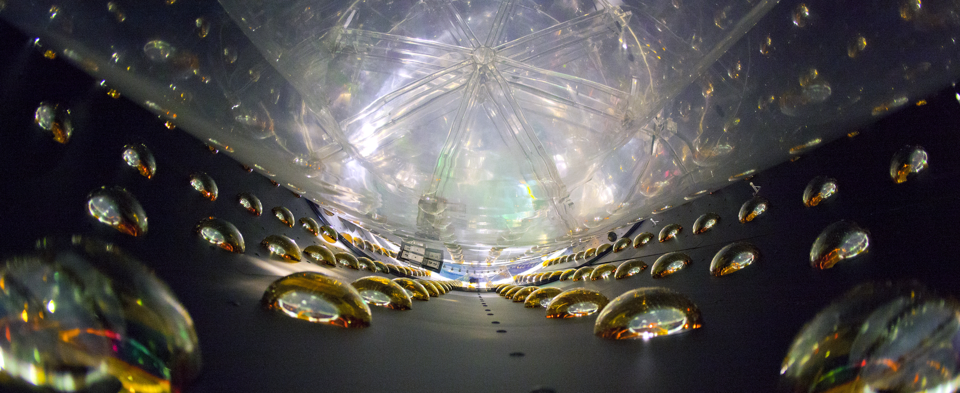
summary
The standard model is a very accurate description of the universe in which we live, but it is no free from issues.
It is riddled with problems and puzzles. Be it the strong CP problem, or muon g-2 problem, or any other problems almost all are pointing at physics beyond the standard model.
There is a lot of unexplored water, and insane number of open questions that still riddle our understanding of WHAT the universe is made of.
Sit down, ponder and go crazy with a theory explaining the universe, and who knows you might be the next Feynman

Slide 15
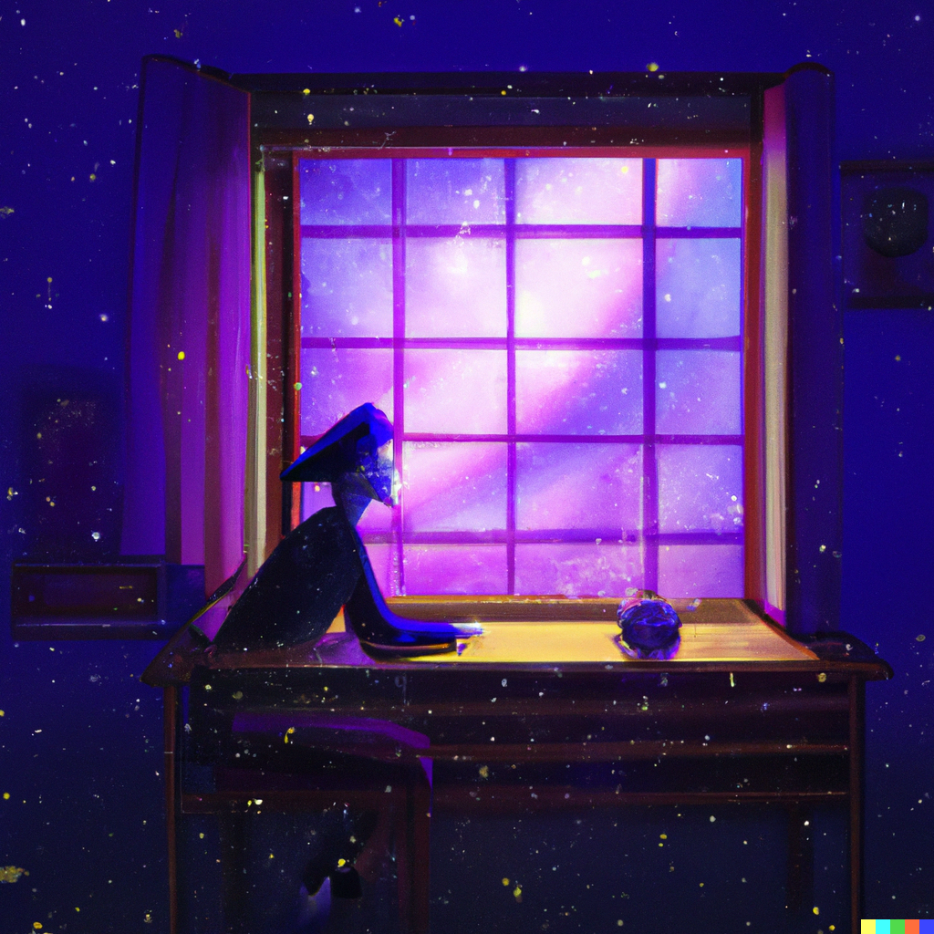
Thank you
`
Adithya A Rao
9483813602​
adithyarao3132001@gmail.com​

